Slide 1
Significant Social Media use in National Electoral Campaigns and Social Polarization: A Computational Social Science Approach
Dylan Cattie and John Mathena
INSPIRE Project
Notes:
Mention the overarching goals of the INSPIRE project
Measure perceived grievance to track unrest in real time
Political polarization surrounding an election could be a good indicator of unrest

Slide 2
Nigeria
“@Mini_Buhari @FunkeBaruwa And elections in Nigeria is often NOT about conviction. More often it's just a game of godfathers, cash n thugs.”

Slide 3
Zambia
“Events of this week have confirmed that PF is too stupid to rule.Can we please vote them out on 20.01.15. Vote wisely! Vote HH! @HHichilema”

Slide 4
Kenya
“RT @roomthinker: If folks by now don't see from their utterances that neither CORD nor Jubilee give a rat's a** about this country - the …”

Slide 5
South Africa
“@Maimaneam @helenzille @LindiMazibuko DA IS WINNING THIS YEAR !”

Slide 6
General Question
How does social media usage alter social polarization surrounding a national election?
Platform for discussion and compromise? (lower polarization)
or
Users reinforce and solidify beliefs? (higher polarization)

Slide 7
Theoretical background
Hypothesis: Social media usage increases polarization surrounding an election
Ideological echo chambers
Extremes rise to prominence
Social media reflects actual life

Slide 8
National elections
Nigeria 2015
Zambia 2016
Kenya 2013
South Africa 2014
Notes:
Collected relevant tweets from 60 days before and 30 days after the election date

Slide 9
How do we measure the emotional content of tweets?
Code them for:
Objectivity
Is it a statement of fact or not?
Sentiment
Is it positive or negative?
Intensity
How positive or negative is it?
Notes:
Talk about relevance in Q and A if necessary

Slide 10
Tweet coding scheme
Objectivity coding scheme
1 objective
0 subjective
Sentiment coding scheme
+2 - very positive
+1 positive
0 neutral or objective
-1 negative
-2 very negative
“RT @Julius_S_Malema: We will soon announce the date of the march to the union buildings to demand Zuma's resignation as the president”
“RT @ShottaZee: We extend our birthday wishes to the jail-bound outgoing @SAPresident Zuma. Enjoy. Last one as a free man. #ASIJOKE”
Notes:
Insert example tweets

Slide 11
Sentiment intensity
The proportion of intense tweets relative to total tweets
Intense tweets = very positive (+2) and very negative (-2) tweets
Compare pre election to post election
Intensity % = (# intense tweets / total # of tweets) x 100
Notes:
Used an R script

Slide 12
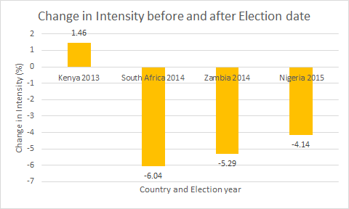
Results
Very large effect size
Cohen’s d = 1.05
Each country’s sentiment intensity decreased post election
Except Kenya 2013
Notes:
INSERT GRAPH HERE

Slide 13
Discussion
Why did most countries decrease in polarization?
Post election fatigue
Reduction in motive
Why did Kenya increase in polarization?
ICC role?
Remnant of 2007?
Poll errors?
Is the intensity measure effective?
Yes given effect size

Slide 14
Limitations
Only 60 days before and 30 days after election
Only 4 countries
Choice of country was not based on internet penetration
No control (baseline)

Slide 15
Future Steps
Measuring intensity in more elections (US, Tunisia, Malawi, Gambia, etc.)
Increasing time period
Moving into other languages (Arabic, Spanish, etc.)
Increasing Inter-rater reliability

